Slide 1
From Insights to Action: Unlocking the Potential of Gaming Data for Strategic Growth
Introduction
ANALYtics
Recommendation
Sql test
Data ANALYSIS
Alif Gala Buana – Data Analyst

Slide 2
TABLE OF CONTENT
Introduction
Analysis
01
02
Recommendation
Sql test
03
04
Introduction
ANALYtics
Recommendation
Sql test
Data ANALYSIS

Slide 3
Introduction
01
Introduction
ANALYtics
Recommendation
Sql test
Data ANALYSIS

Slide 4
Exclusive Summary
Background
Key-insight
Introduction
ANALYtics
Recommendation
Sql test
Data ANALYSIS
Eklipse is a platform that processes gaming sessions and user-generated clips, offering video editing, sharing, and download features. Users are categorized as Free or Premium, with Free users significantly outnumbering Premium users.
The majority of gaming sessions are contributed by Free users, though they exhibit lower engagement compared to Premium users.
Games like COD: Warzone, Fortnite, and Apex Legends drive significant activity and are key drivers of user engagement on the platform.
Targeted promotional strategies for Free users could effectively increase Premium user conversion rates.

Slide 5
PROBLEM VS SOLUTION
Problem STATEMENT
Goal & objective
Introduction
ANALYtics
Recommendation
Sql test
Data ANALYSIS
The company faces challenges in increasing Free-to-Premium user conversions and determining which games to focus on to drive greater engagement.
VS
Analyze behavioral differences between Free and Premium users.
Identify games dominating user activity on the platform.
Provide strategic recommendations to boost Premium subscriptions.

Slide 6
DATA PROCESSING
Data cleaning & PREPROCESSING
Data Analytics
Recommendation
Introduction
ANALYtics
Recommendation
Sql test
Data ANALYSIS
Handling missing data, removing duplicates, and converting data formats to datetime for further analysis.
Analyzing the frequency, duration, and clip engagement between Free and Premium users to quantify behavioral differences, while also identifying the top 5 most frequently played games, the games with the highest number of downloaded clips, and the games with the most shared clips among both Premium and Free users.
Encouraging Free users to subscribe to Premium by offering exclusive content and focusing on games that are frequently played, have the most downloaded clips, and the most shared gameplay clips.

Slide 7
Analytics
02
Introduction
ANALYtics
Recommendation
Sql test
Data ANALYSIS
Behavioral Differences: Free vs Premium Users

Slide 8
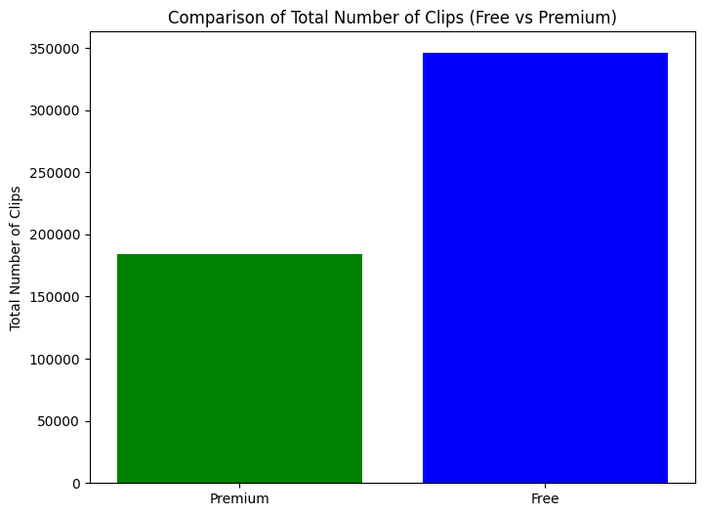
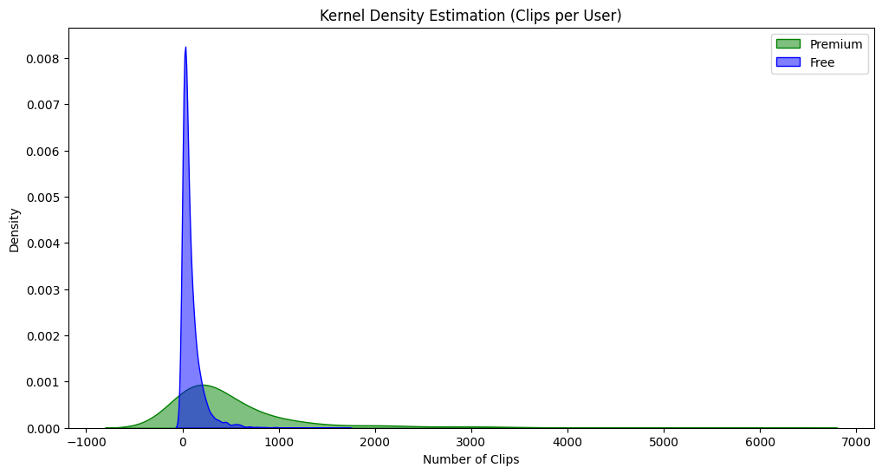
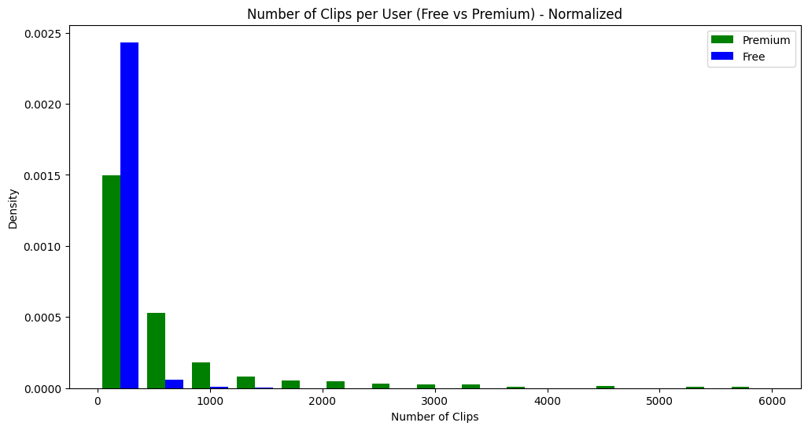
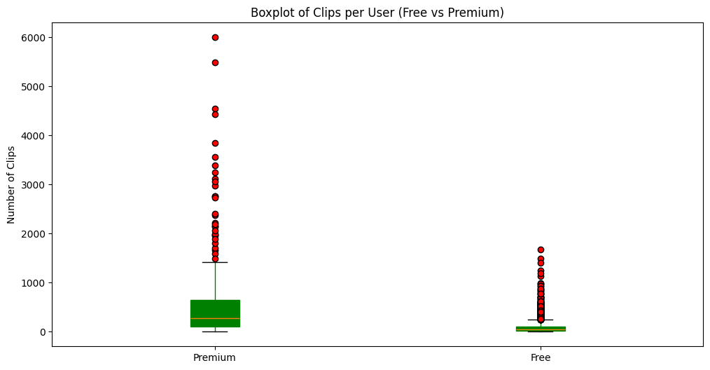
Clips-ANALYtics
Introduction
ANALYtics
Recommendation
SQL TEST
Data ANALYSIS
Total Clips:
Free users generate significantly more clips than Premium users.
Free users form the main user base, while Premium users show more stable activity.
Distribution of Clips
The majority of users (both Free and Premium) upload a small number of clips.
Free users have a wider spread and more outliers with high activity, as seen in the KDE and histogram..
Boxplot
Free users show higher variability and more extreme outliers in clips per user compared to Premium users.
Premium users have a more consistent range of activity.

Slide 9
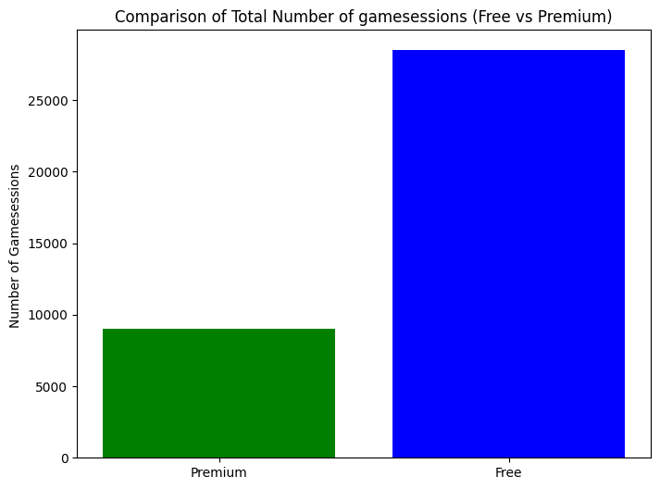
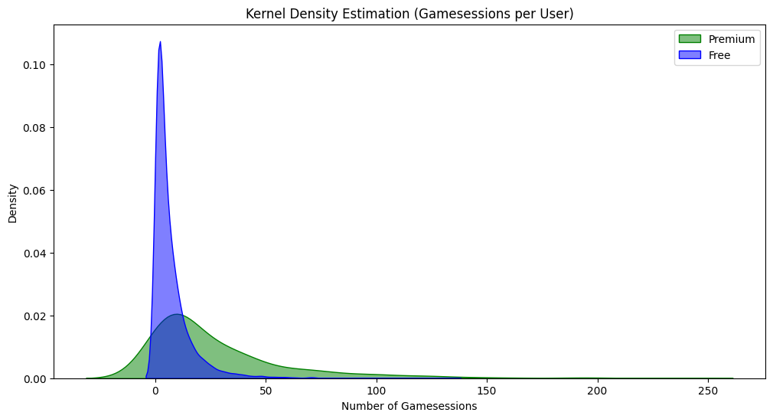
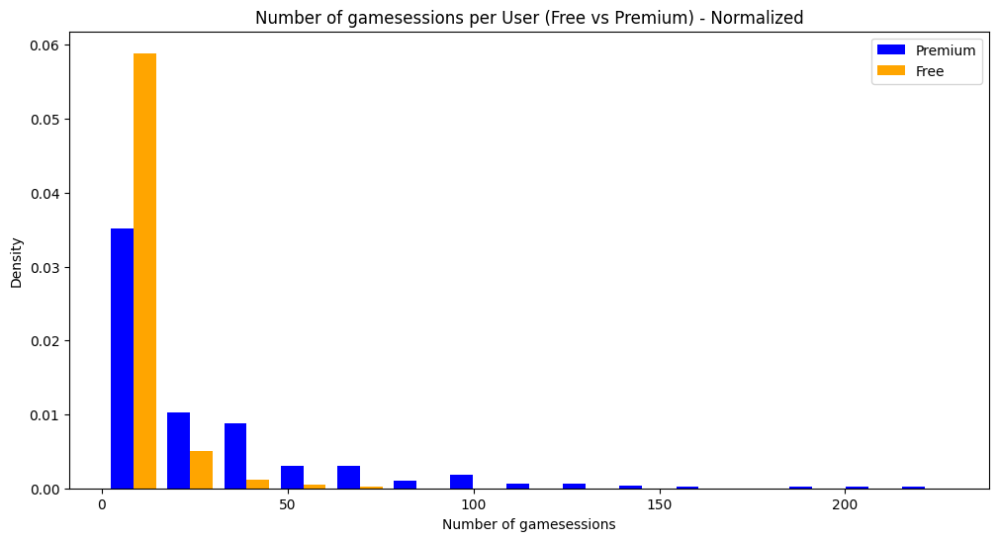
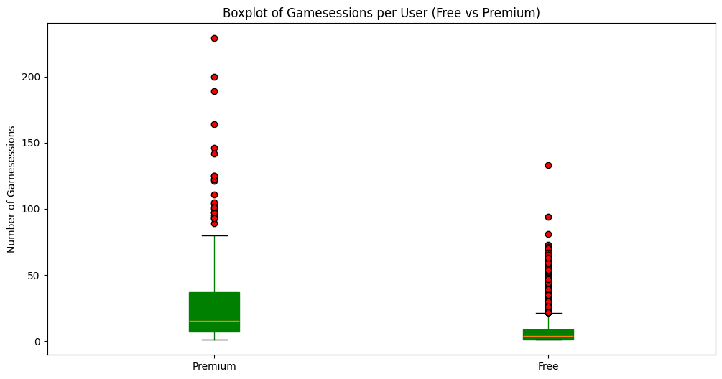
gamesessions-ANALYtics
Introduction
ANALYtics
Recommendation
SQL TEST
Data ANALYSIS
Total Gamesessions
Free users have a much higher total number of game sessions due to a larger user base.
Distribution of Gamesessions per User
Free users tend to play less, while Premium users play more frequently.
Boxplot
Premium users have a higher average number of sessions, though Free users show more variation.

Slide 10
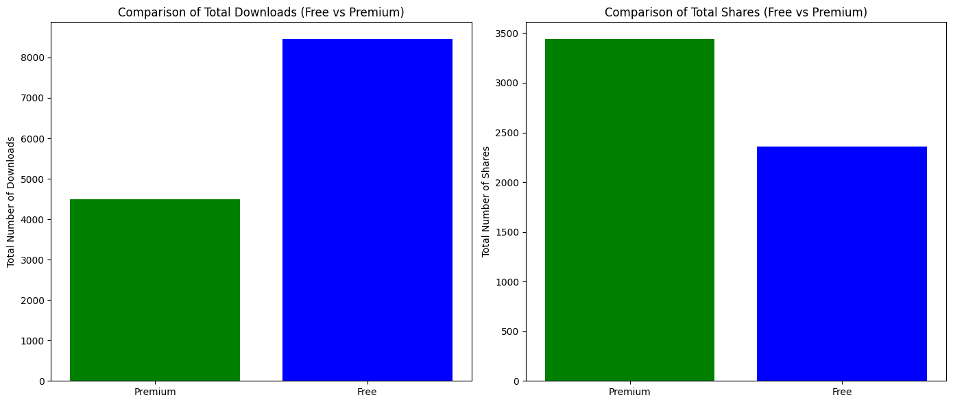
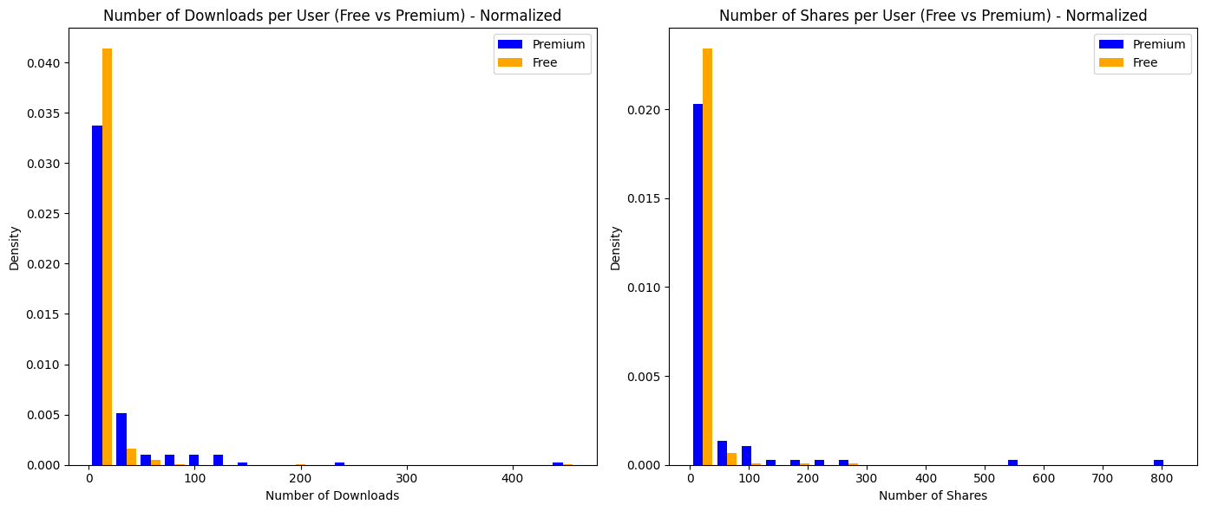
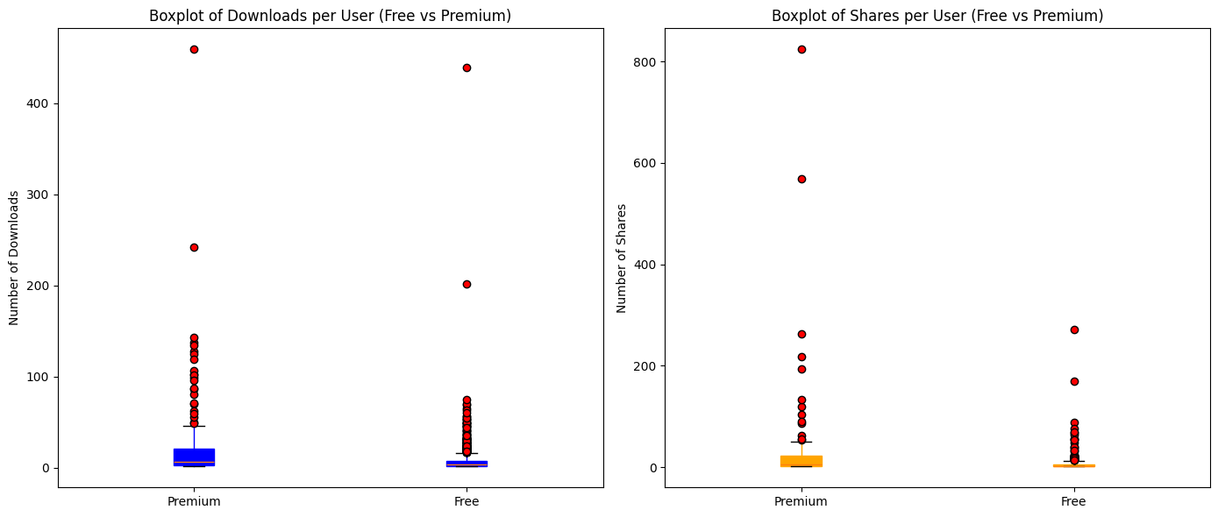
Downloaded and shared clips -analytics
Introduction
ANALYtics
Recommendation
SQL TEST
Data ANALYSIS
Total Downloaded and shared clips
Free users have more total downloads than premium users, showing higher access or enthusiasm for downloading.
Premium users perform more shares than free users, indicating stronger engagement in sharing clips.
Distribution of Download and shared clips
Most users have low download activity, with free users showing slightly wider variation than premium users.
Premium users display higher sharing activity per user compared to free users, though both groups mostly have low activity.
Boxplot
Free users have a higher median, but premium users include outliers with very high download activity.
remium users show a higher median and more consistent sharing behavior, with fewer outliers compared to free users.

Slide 11
Analytics
02
Introduction
ANALYtics
Recommendation
SQL TEST
Data ANALYSIS
Strategic Focus: Game Recommendations for Growth

Slide 12
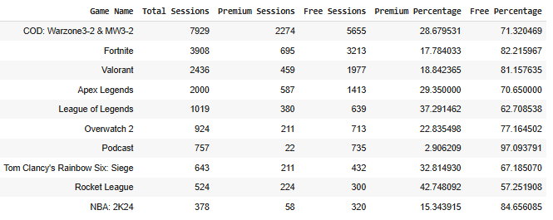
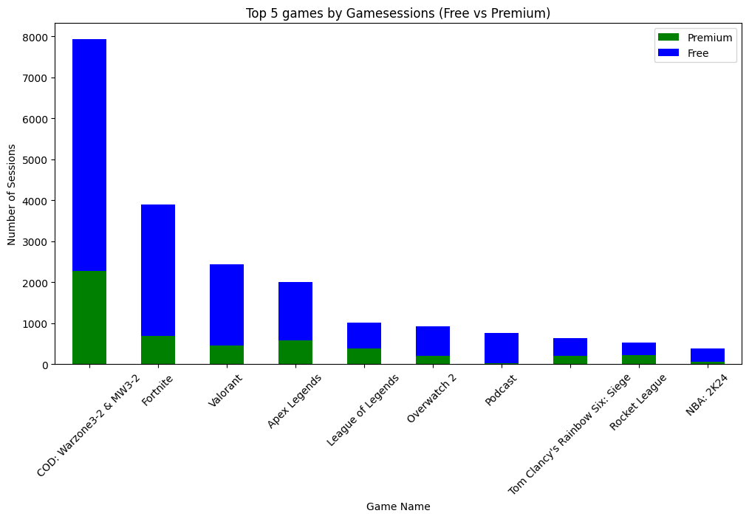
Top 10 Games Based on Game Sessions
Introduction
ANALYtics
Recommendation
SQL TEST
Data ANALYSIS
Highest Premium User Base:
Free users dominate total sessions for most games, particularly in Fortnite and COD: Warzone 2.0 & MW2-3.2.
League of Legends (37.4%) and Overwatch 2 (36.9%) have a significant proportion of premium users compared to other games, demonstrating their success in attracting paying users.
Potential for Free-to-Premium Conversion:
Games like Rocket League (42.7% premium) and Valorant (18.8% premium) show a promising opportunity to convert free users to premium by offering exclusive features or incentives.
Monetization Strategy:
Games with low premium user percentages, like Podcast or NBA 2K24, can focus on promotional campaigns or exclusive features to attract more premium users.

Slide 13
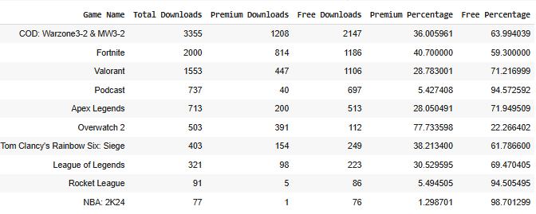
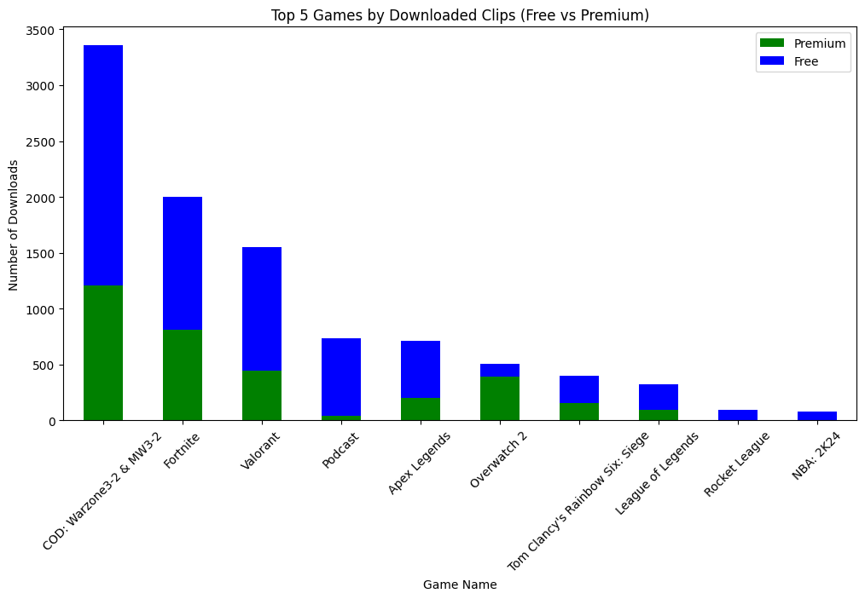
Top 10 Games Based on Downloaded Clips
Introduction
ANALYtics
Recommendation
SQL TEST
Data ANALYSIS
Premium Users Contribute Notably in Certain Games:
Podcast (45.5%) and Valorant (28.7%) have notable premium downloads, showing they successfully provide value to premium users with exclusive or high-quality clips.
Potential for Free-to-Premium Conversion:
Rocket League (1.5%) and NBA 2K24 (1.2%) have very low premium user engagement in clip downloads, likely due to limited exclusive content or low interest from paying users.
Opportunities to Monetize Clips:
Games like Fortnite and COD: Warzone 2.0 & MW2-3.2 can add premium-exclusive features (e.g., advanced editing or high resolution) to boost clip downloads from premium users (make Free Users to be premium users).

Slide 14
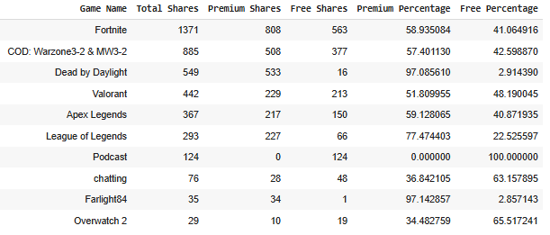
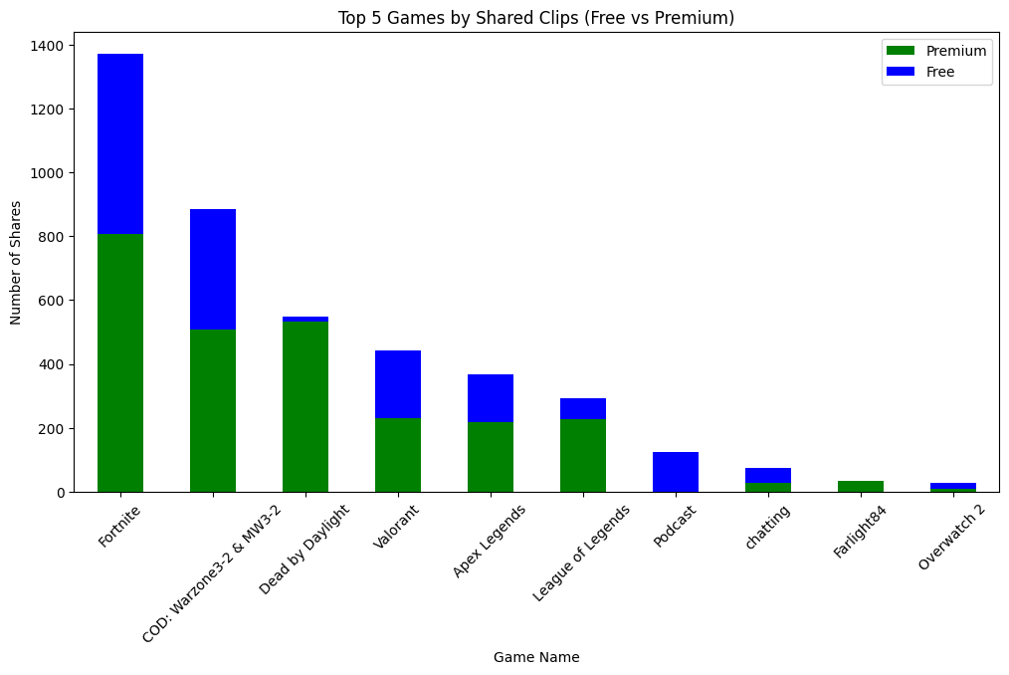
Top 10 Games Based on shared Clips
Introduction
ANALYtics
Recommendation
SQL TEST
Data ANALYSIS
Premium Users as Significant Contributors in Specific Games:
Dead by Daylight (97.09%) and Farlight84 (97.14%) rely heavily on premium users for shared clips, likely due to exclusive features or higher engagement.
League of Legends (77.44% premium shares) sees strong premium user contributions, suggesting competitive games attract more paying audiences.
Opportunities for Monetization and Engagement:
Fortnite and COD could add exclusive clip-sharing features for premium users, like advanced tools or in-game rewards, to boost premium engagement.
Low Premium User Engagement in Certain Games:
Overwatch 2 shows a higher proportion of free shares (55.52%), reflecting limited interest or fewer exclusive clip-sharing features for premium users.
Games like Apex Legends and League of Legends, while popular, still show a moderate level of free user participation compared to premium users.

Slide 15
Recommendation
Introduction
ANALYtics
Recommendation
SQL TEST
Data ANALYSIS
Convert Free to Premium
Boost Engagement
Offer exclusive features (e.g., advanced editing, high-res downloads).
Launch limited-time discounts and gamification rewards.
Introduce community features (forums, leaderboards).
Use personalized notifications to highlight Premium benefits.
Focus on Game-Specific Strategies
Optimize Clip Monetization
Premium-exclusive downloads (e.g., no watermark, high resolution).
Focus on sharing engagement for Dead by Daylight and League of Legends.
Promote exclusive content in games with high Free-user activity.
Collaborate with streamers to drive Premium adoption.

Slide 16
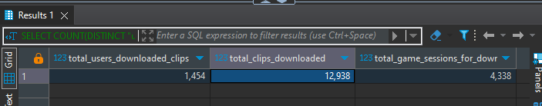
Sql test
Introduction
ANALYtics
Recommendation
SQL TEST
Data ANALYSIS
The total number of users who have downloaded any clips. The total number of clips downloaded. The total number of game sessions from which the downloaded clips were generated.
Query:
SELECT COUNT(DISTINCT "user_Id" ) AS total_users_downloaded_clips,
COUNT(*) AS total_clips_downloaded,
COUNT(distinct "gamesession_Id") AS total_game_sessions_for_downloaded_clips
FROM downloaded_clips;
Output:

Slide 17
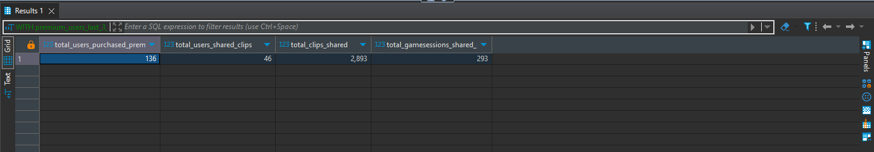
Sql test
Introduction
ANALYtics
Recommendation
SQL TEST
Data ANALYSIS
For users who purchased premium in the last 3 months: Get the number ofusers who purchased premium, the number of users who shared any clips,the total number of clips shared, and the total number of gamesessions from which the shared clips were generated
Query:
WITH premium_users_last_3_months AS (
SELECT user_id
FROM premium_users
WHERE starts_at >= '2023-10-01' AND starts_at <= '2023-12-31'
)
SELECT
COUNT(DISTINCT pu.user_id) AS total_users_purchased_premium,
COUNT(DISTINCT s.user_id) AS total_users_shared_clips,
COUNT(s.clip_id) AS total_clips_shared,
COUNT(DISTINCT s.gamesession_id) AS total_gamesessions_shared_clips
FROM premium_users_last_3_months pu
LEFT JOIN shared_clips s ON pu.user_id = s.user_id;
Output:

Slide 18
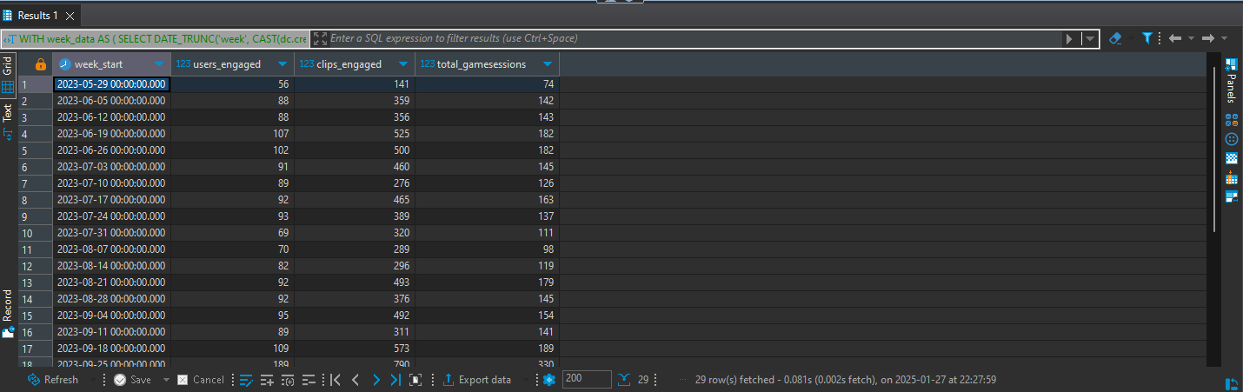
Sql test
Introduction
ANALYtics
Recommendation
SQL TEST
Data ANALYSIS
Calculate, on a weekly basis: The number of users engaged. The number of clips engaged. The total number of gamesessions from which the engaged clips were generated.
Query:
WITH week_data AS (
SELECT
DATE_TRUNC('week', CAST(dc.created_at AS TIMESTAMP)) AS week_start,
dc."user_Id" AS user_id,
dc.clip_id,
dc."gamesession_Id" as gamesession_id
FROM downloaded_clips dc
UNION ALL
SELECT
DATE_TRUNC('week', CAST(sc.created_at AS TIMESTAMP)) AS week_start,
sc."user_id" AS user_id,
sc.clip_id,
sc.gamesession_id
FROM shared_clips sc
)
SELECT
week_start,
COUNT(DISTINCT user_id) AS users_engaged,
COUNT(DISTINCT clip_id) AS clips_engaged,
COUNT(DISTINCT gamesession_id) AS total_gamesessions
FROM week_data
GROUP BY week_start
ORDER BY week_start;
Output:

Slide 19

THANKS!
Introduction
ANALYtics
Recommendation
SQL TEST
Data ANALYSIS
Do you have any questions?
alifgala05@gmail.com
+62 823-2477-5894
https://www.linkedin.com/in/alifgalabuana/

